Slide 1


FISHEYE-CRUCIBLE
Presented by : Sudhanshu Srivastava

Slide 2
Agenda
Overview
Benefits of FishEye-Crucible
Repository management(local/remote)
User/Groups (Built-in/Jira Authentication)
Smart Commits
Web-hooks
Mail Server Configuration
Crucible workflow
Crucible Project Creation and Jira Issue creation.
Crucible’s features
Demo

Slide 3
Overview
FishEye is a source code repository browser which provides a read-only window into your Subversion, Perforce, CVS, Git, and Mercurial repositories, all in one place. Keep a pulse on everything about your code.
Crucible is a collaborative code review application. It allows your development teams to catch major defects, improve code architecture, and discuss desired improvements, without the need for meetings.

Slide 4
Benefits of FishEye-Crucible
FishEye allows you to extract information from your source code repository and display it in sophisticated manner
Crucible allows you to request , perform and manage code reviews
It can be integrated with all Atlassian Products
Less maintenance
Link source with JIRA issues, crucible code review and Bamboo builds

Slide 5
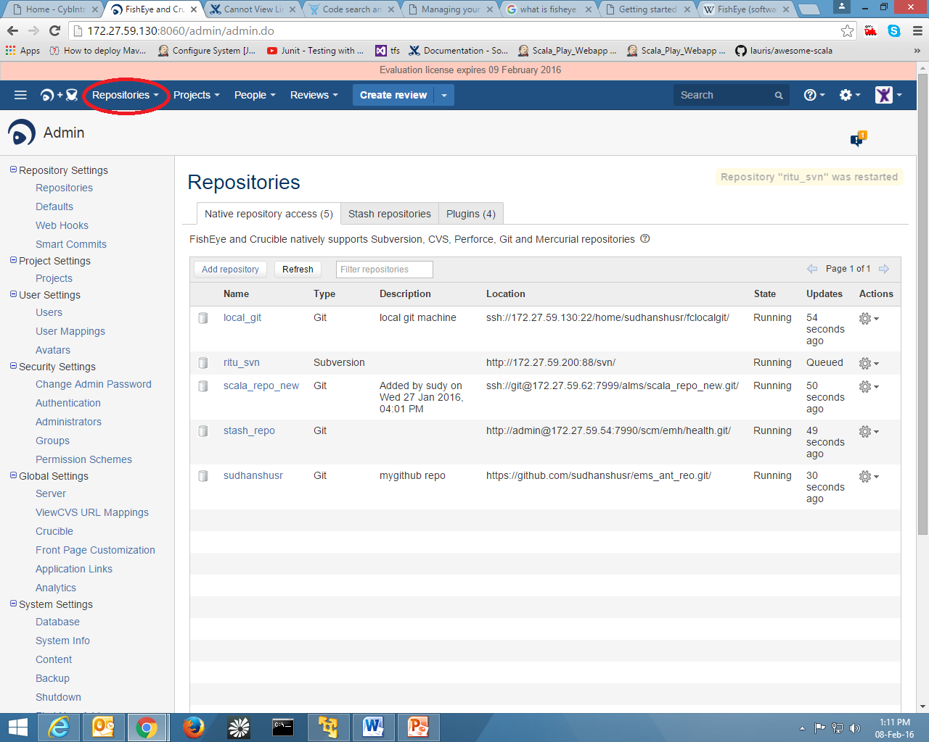
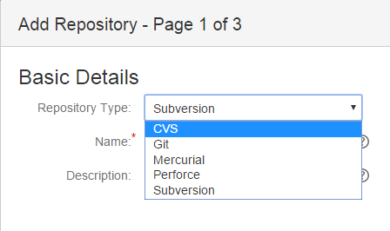
Adding Repository.
We can add CVS, Git, Mercurial, Perforce, Subversion and Stash repositories in Fish-eye.
When you add a repository, and enable it, FishEye builds an index and cache, which may take some time to complete

Slide 6
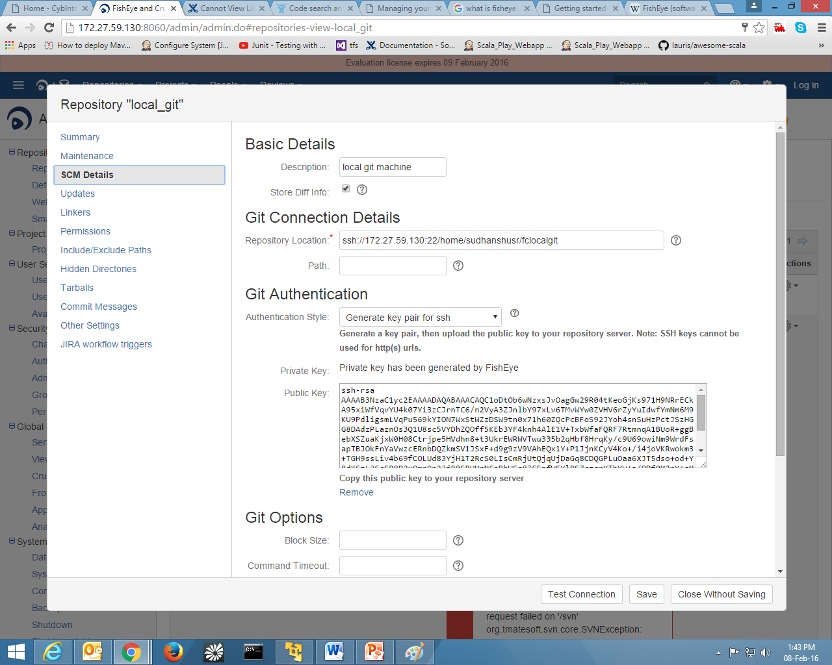
How to add local Git Repository.
To add local git repo we need to use ssh(if on linux).
Also must generate a ssh key in crucible and place that key to file authorized_key that resides at root→.ssh→authorized_key

Slide 7
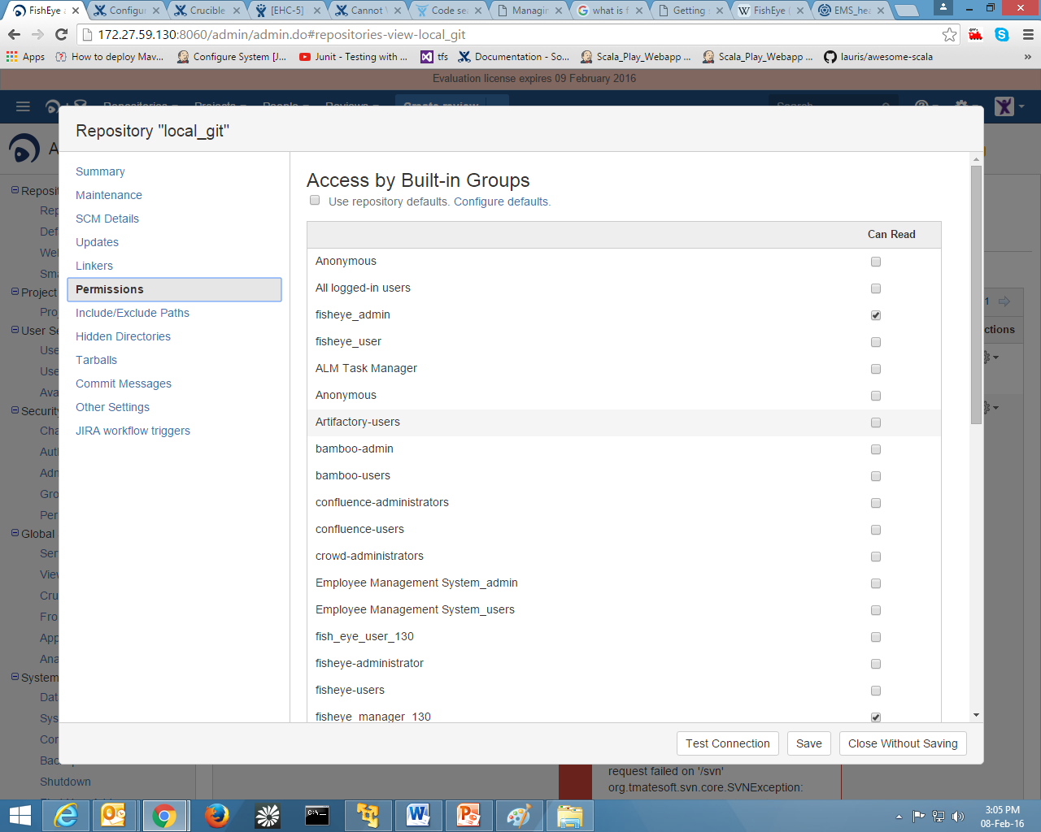
Repository Permission to Groups
We can configure Groups of Users to have specific Repository permission.
Login with admin credentials go to specific project.
On permissions tab you can restrict group to use that repo.

Slide 8
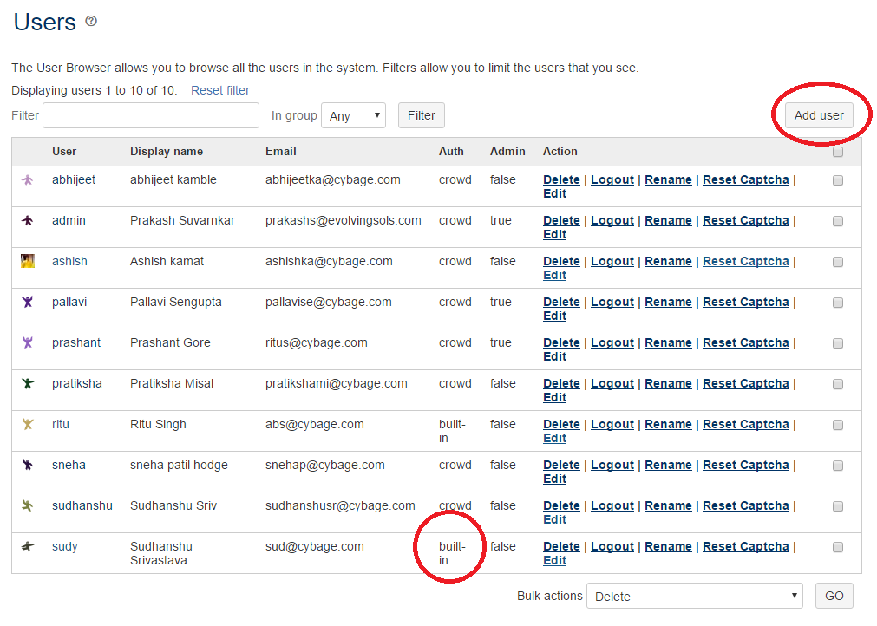
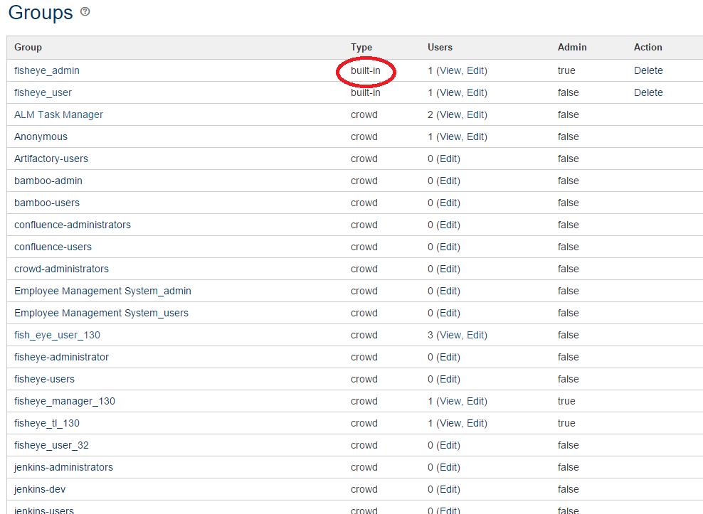
User/ Groups Creation(built in)
To create new user go to Admin→user setting→users
To create new groups go to admin→Security settings→Groups

Slide 9
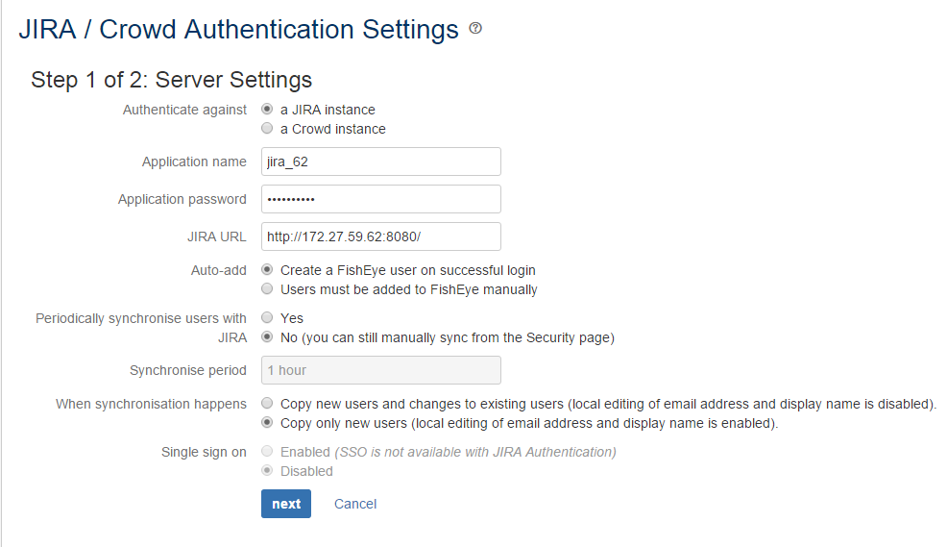
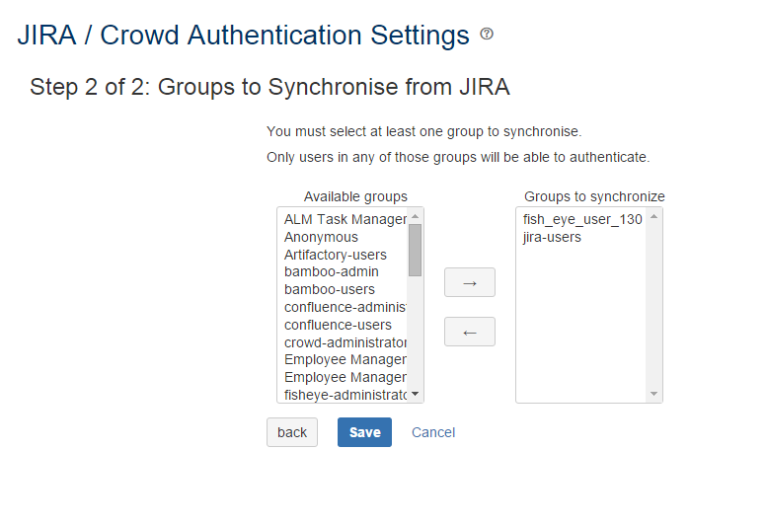
Jira/Crowd Authentication
Under Authentication Section go to Jira/crowd authentication to add your Jira instance.
This will allow Jira user and group to be in Fisheye-Crucible.

Slide 10
Smart Commits
Using smart commits:
Smart commits allow repository committers to perform actions such as transitioning JIRA issues by embedding specific commands into their commit messages
Basic command line syntax
The command line syntax for a commit comment is:
<ISSUE_KEY> #<COMMAND> <optional COMMAND_PARAMETERS>
Eg. EHC-5 #comment for jenkins ##done Fixed a bug

Slide 11
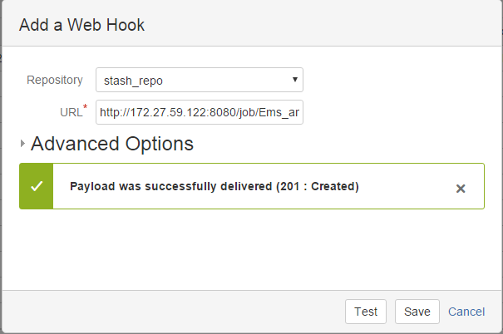
Web hooks
Web hooks will trigger Jenkins build for any commit in SCM.
To configure it under Repositories Settings→Webhooks→Add
Select a repo on which you want to configure hook
Add jenkins job url also add /build in last
Exmp: http://172.27.59.122:8080/job/Ems_ant_stash/build

Slide 12
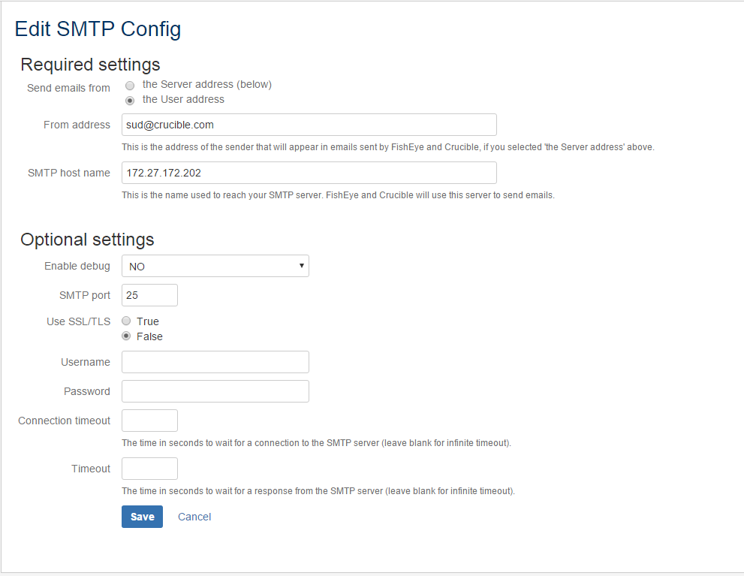
Configuration of Mail Server
Go to Global-Settings→Server→Mail Server
Add SMTP host url name and port.
.

Slide 13
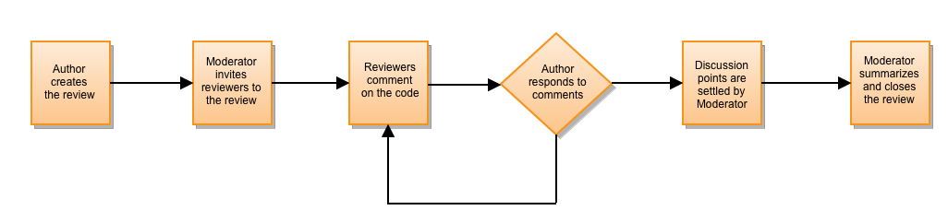
Crucible Workflow
Authors: Usually the creator of the code; the person who will act on the review's outcome.
Reviewer: A participant that will comment on the source files in the review, raising points and discussion on the work that was done.
Moderator: Usually the person who starts the review and is responsible for deciding the outcomes and closing it.

Slide 14
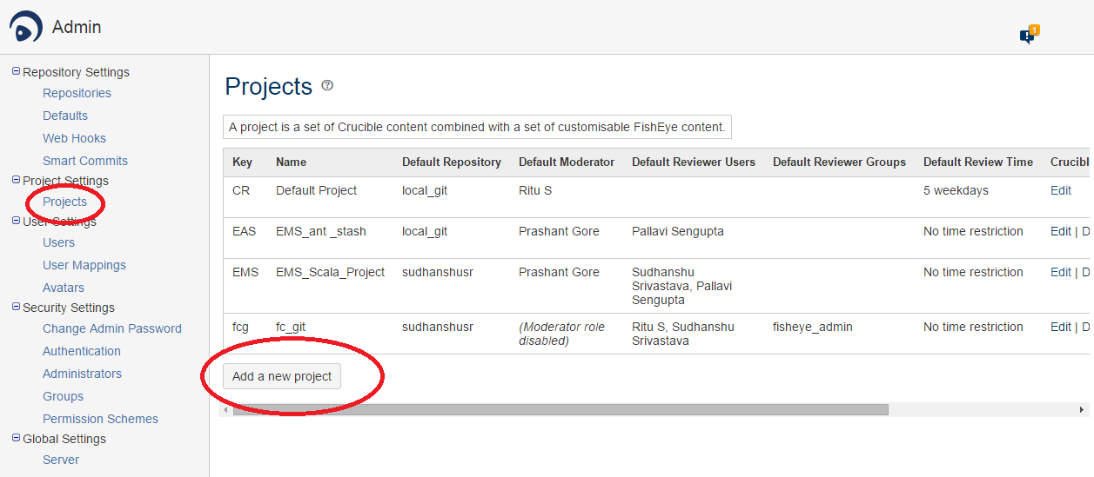
CRUCIBLE Project Creation
Collaborative peer code review
Create a project in Crucible

Slide 15
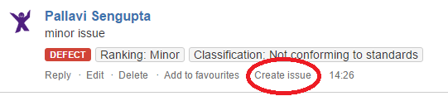
Creating issue in JIRA
Creating issue in JIRA
.

Slide 16
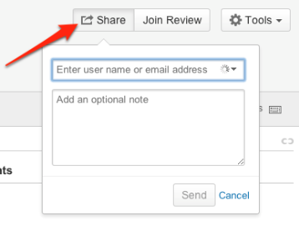
Review Reminders
Once you Configure SMTP, you can use this feature.
When a review has a deadline (due date), you can have Crucible send a preset

Slide 17
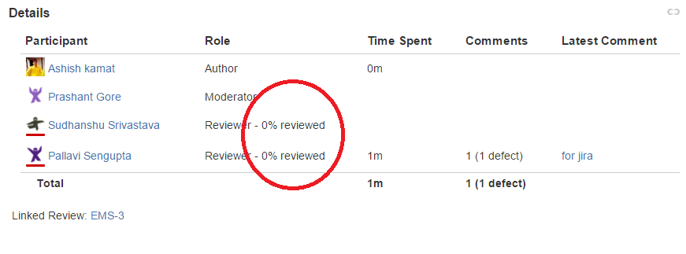
Progress Tracking
Crucible tracks the ones you have viewed.

Slide 18
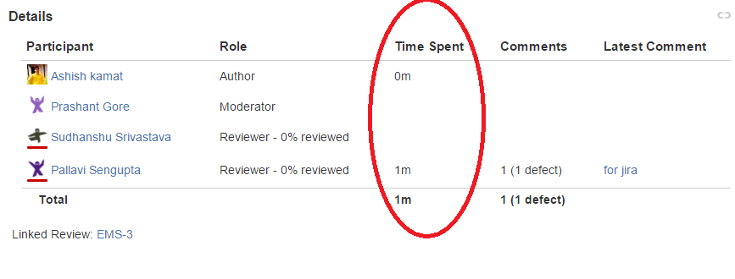
Time Tracking
Time Tracking
Crucible will automatically track the time you spend in a Crucible review.

Slide 19
Any Questions?

Slide 20
Thank you!

